Slide 1




ALL IN

Slide 2
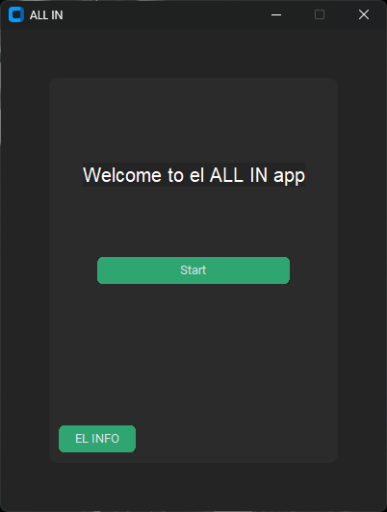
WELCOME TO OUR APP
We created this app to make it easier to learn , train
and test a model using some algorithms we have added

Slide 3

WHY OUR APP?
instead of using Jupyter notebook or coding You just click some buttons and our app do the rest for you!
"I make your life easier"

Slide 4
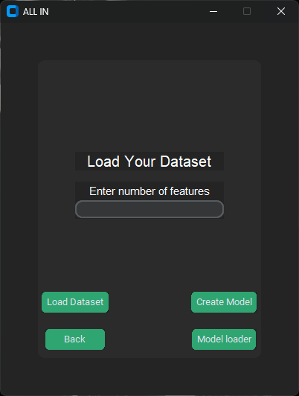
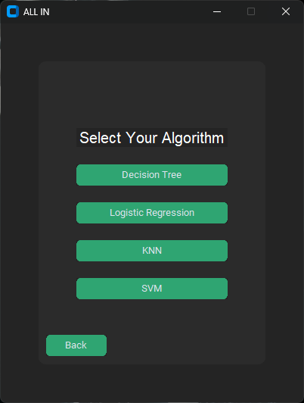
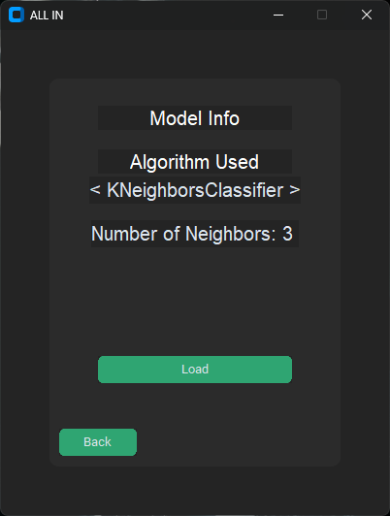
FUNCTIONS
01
02
You can import any preprocessed dataset
We give you the ability to choose the classification algorithm you want to train your model with
03
04
After you train and test your model we show you the accuracy , precision , recall , f1 score and confusion matrix same as its shown in your Jupyter notebook
You can also save and load your model and shows you some informations about it

Slide 5
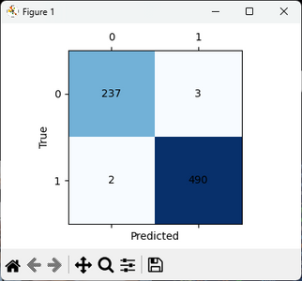

NEWLY ADDED FEATURE
Confusion Matrix
SVM algorithm
With just a click of a button You can see the confusion matrix of the model to see its score in the test section
We have added svm algorithm to the collection of the classification algorithms

Slide 6

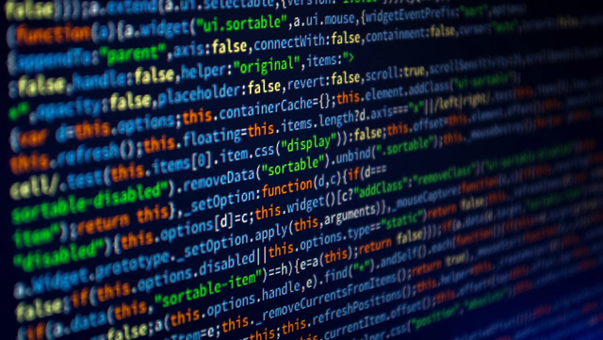

FUTURE UPDATES
001 Model loader
002 More ALgorithms
003 Another version
A better model loader to import any trained model and test its accuracy on a datasets
More algorithms will be added not just classification algorithms !!
For those who have Macbook or apple silicon we will make a version that suits their OS or maybe a web app

Slide 7
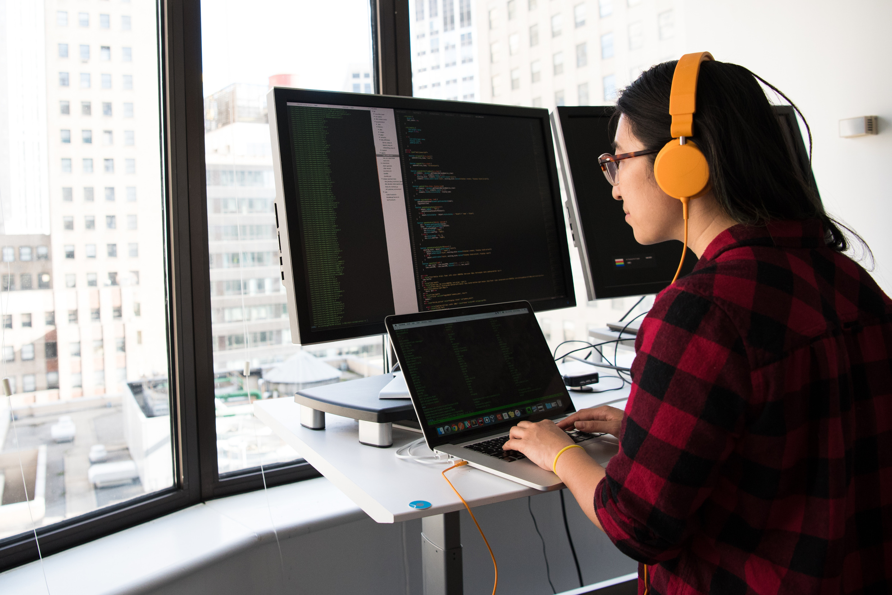

DEVELOPERS
Belal Ehab El gendy
Boules Hany
Basma Ahmed El morsy
Sarah Hassan Taha
Youssef Yasser Youssef

Slide 8

THANK YOU

